Slide 1
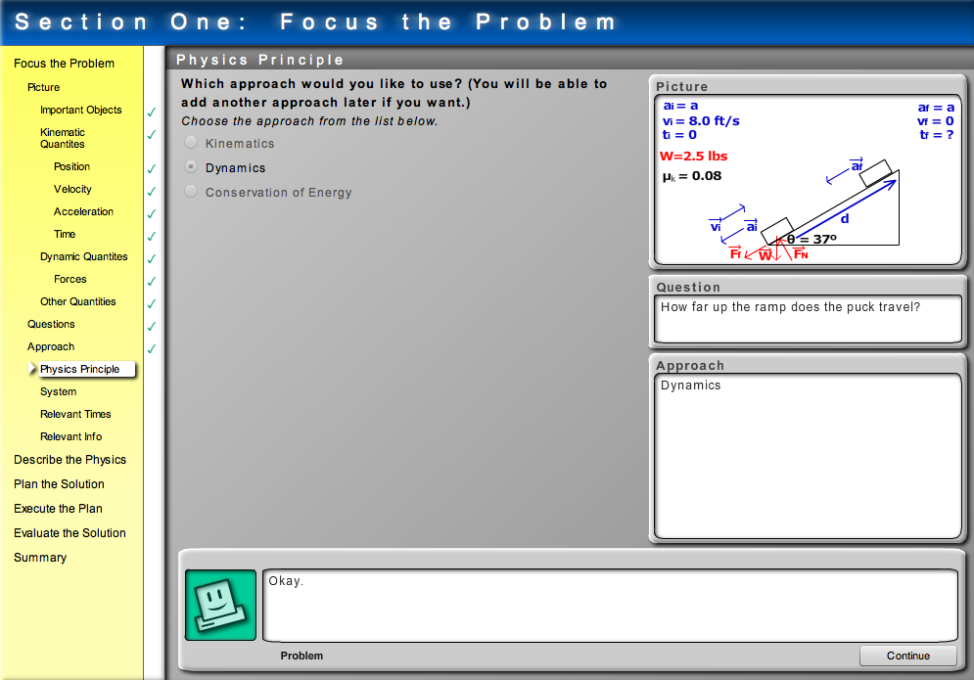
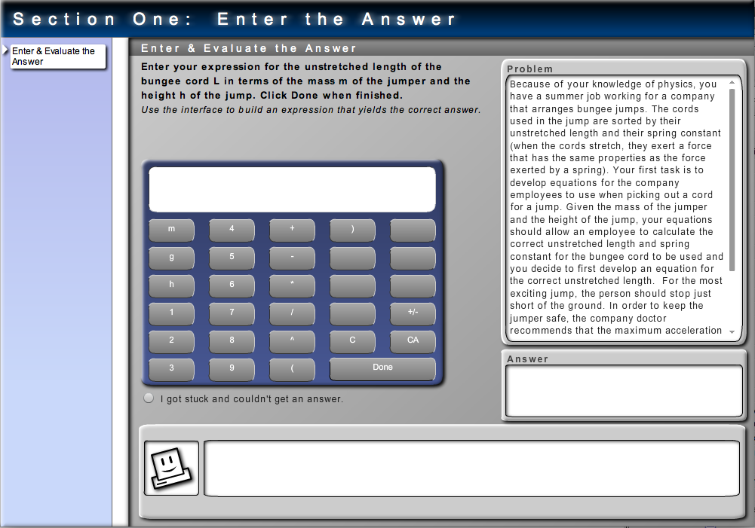
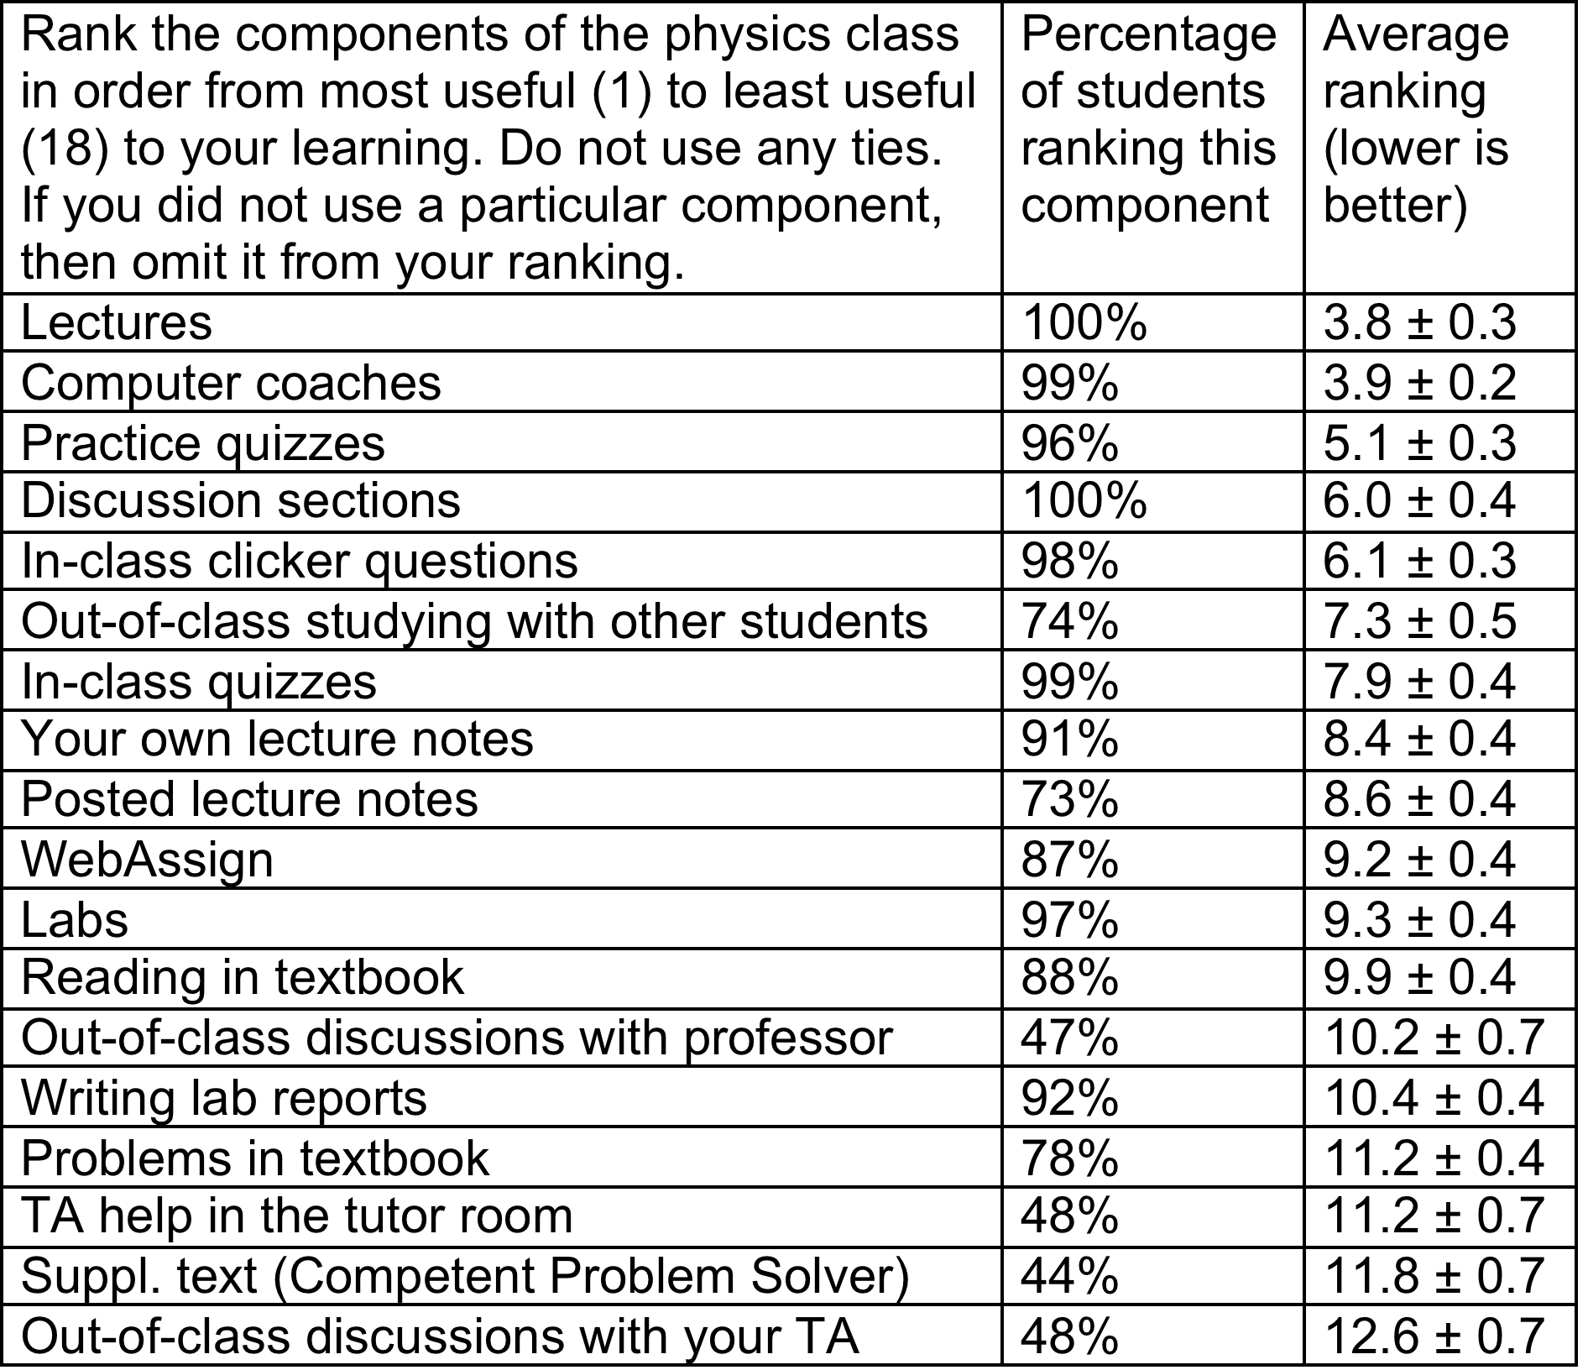
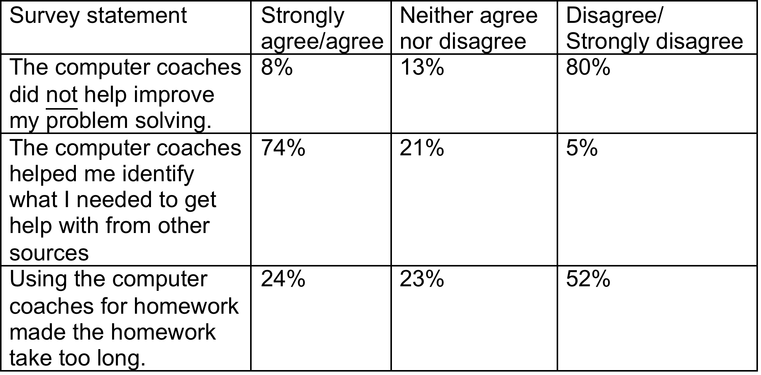
INTERNET COACHES FOR PROBLEM SOLVING IN INTRODUCTORY PHYSICS: Experimental Design
Leon Hsu ¹, Qing Xu², Ken Heller ^{2,} Bijaya Aryal³
1. Department of Postsecondary Teaching and Learning, University of Minnesota–Twin Cities
2. School of Physics and Astronomy, University of Minnesota–Twin Cities
3. Center for Learning Innovation, University of Minnesota–Rochester
Supported by the National Science Foundation DUE-0715615.
Goal and design
Goals
Experimental Design
• Data collected from students included:
- Pre and post-test scores on the FCI, CLASS, and a
math diagnostic test
- Solutions to 13 free-response problems from
4 midterms and the final exam.
- Responses to a survey on the utility of various course
components (lecture, discussion, lab, coaches, etc.)
• Final exam solutions from another section of the same class
with a different instructor and no computer coaches were
also collected.
• Test the usability and utility of computer programs
designed to provide students with individualized
coaching while solving problems.
• Coaching programs are designed within the
framework of a cognitive apprenticeship and provide
scaffolding in conjunction with the processes of
modeling, coaching, and fading.
• Coaching programs emphasize the process of
decision-making in solving problems.
• 35 computer coaches were incorporated into a 219-
student section of a calculus-based introductory
mechanics course
• Students could complete their homework by working
through the coaches or by entering a correct answer in
WebAssign (within three tries).
• Students usage of the coaches was tracked by recording
their keystrokes while they worked through the coaches.
Computer Coaches
Mode 1 – Guidance
C guides, S decides, C assesses
Mode 2 – Debugging
C decides or asks help, S assesses, C responds
Mode 3– Independent practice
S solves or asks for help, C questions,
S responds, C assesses
Usability Results
132 survey responses received from students who had completed at least 10 coaches (as verified by log files).
Conclusion: Students believe the coaches are valuable
Out of 219 students, the average number of coaches attempted was 28 and completed was 21.9 out of a maximum of 35. Only 20 students completed fewer than 10 coaches.
Students felt the coaches were the most useful class element for their learning (tied with the lectures).
Students primarily used the coaches for help if they got stuck.
The step-by-step Type I coach was judged the most useful at the beginning of the course. All were judged equally useful at the end of the course.

